Slide 1


BTP Report on Multimodal Approach for DeepFake Detection
Submitted by:
Hitarth(20CS3074)
Anubhav Ladha(20CS3009)
Submitted to:
Dr. Pallabi Saikia
Assistant Professor
Department of Computer Science and Engineering

Slide 2
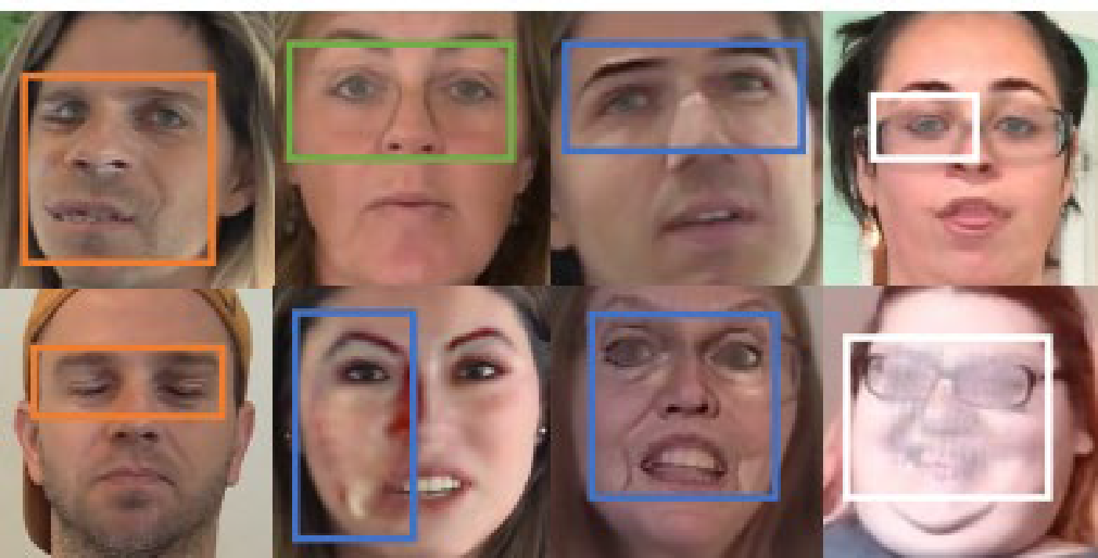
Introduction
Recent years have witnessed the rapid development of DeepFake Technologies, which enables attackers to manipulate the facial regions of image and generate a forged image.
As the synthesized images are becoming more and more photo realistic, it is extremely difficult to distinguish whether an image has been manipulated even for the human eyes. At the same time, these forged images might be distributed on the internet for the malicious purposes which could bring societal implications. The above challenges have driven the development of deep learning.
Large companies like Google invest very much in fighting the DeepFake, this including release of large datasets to help training models to counter this threat. The phenomena rapidly invades the film industry and threatens to compromise news agencies. Large digital companies, including content providers and social platforms are in the front run of fighting Deep Fakes. GANs that generate DeepFakes becomes better every day and, of course, if you include in a new GAN model all the information we collected until now how to combat various existent models, we create a model that cannot be beaten by the existing ones

Slide 3
Introduction
For instance, in figure I give examples form the DFDC dataset. We can see that some forgery traces such as color mismatch occur in small regions(like the mouth corners),while other forgery signals such as visible boundaries that almost span the entire imagefake forensics using deep neural network.
We propose a Multi-modal Multi-scale Transformer (M2TR) for Deepfake forensics, which uses a multi-scale transformer to detect local inconsistencies at different scales and leverages frequency features to improve the robustness. Extensive experiments demonstrate that our method achieves state-of-the-art detection performance on different datasets.
In this project, we present a large-scale and high-quality Deepfake dataset, Swapping and Reenactment DeepFake (SR-DF) dataset, which is generated using the state-of-the-art face swapping and facial reenactment methods for the development and evaluation of Deepfake detection methods.

Slide 4
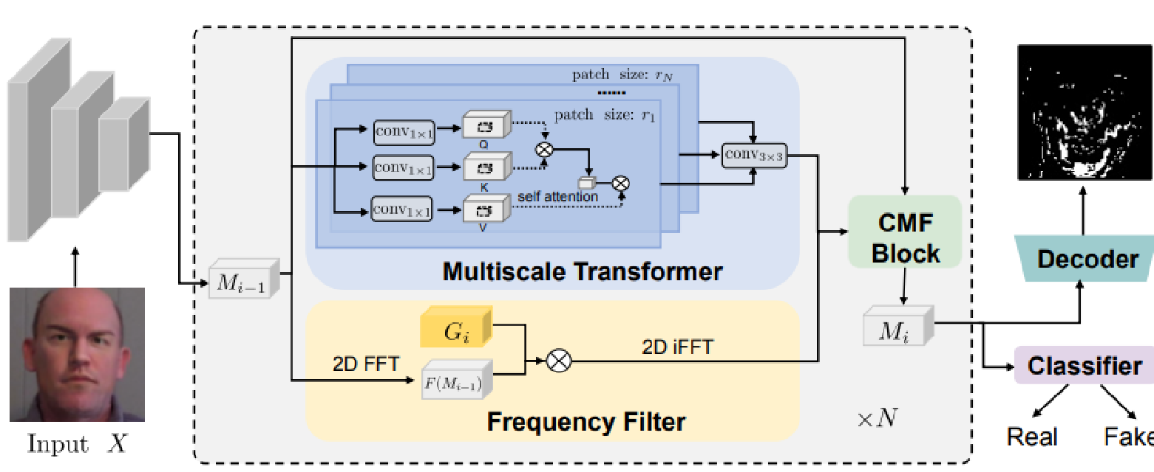
Approach
We aim to detect the subtle forgery artifacts that are hidden in the forged images and improve the robustness to image compression with frequency features.
More formally, we denote an input image as X ∈R 𝐻×𝑊×3 , where H and W are the height and width of the image, respectively. We first use several convolutional layers to extract features 𝐹∈R (𝐻/4)×(𝑊/4)×𝐶 of X, which are then input to successive multiscale transformer and frequency filters for forgery clues detection. The intuition of using convolutions here is to ensure faster convergence and more stable training.

Slide 5
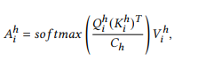
Multi Scale Transformers
To capture forgery patterns at multiple scales, we introduce a multi-scale transformer which operates on patches of different sizes. Taking the output of the previous cross modality fusion block 𝑀𝑖−1 (which is initialized as F) as input, we split it into spatial patches of different sizes and calculate patch-wise self-attention in different heads. Specifically, we first extract patches of shape 𝑟ℎ × 𝑟ℎ ×𝐶 from 𝑀𝑖−1, and reshape them into 1-dimension vectors for the ℎ-th head. After that, we use fully-connected layers to embed the flattened vectors into query embeddings 𝑄 ℎ 𝑖 ∈ R 𝑁 ×𝐶ℎ , where 𝑁 = (𝐻/4𝑟ℎ)×(𝑊 /4𝑟ℎ), and𝐶ℎ = 𝑟ℎ×𝑟ℎ×𝐶. Similar operations are implemented to obtain key embeddings 𝐾 ℎ 𝑖 and value embeddings 𝑉 ℎ 𝑖 , respectively. Then we calculate the attention matrix through the following process :
where 𝐴 ℎ 𝑖 is then reshaped to the original spatial resolution. Finally, the features from different heads are concatenated and further passed through a 2D residual block to obtain the output𝑇𝑖 ∈ R (𝐻/4)×(𝑊 /4)×C.

Slide 6
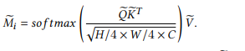
Calculation
Frequency Filter :
where ⊙ denotes the Hadamard product.
Cross Modality Fusion :
Finally, we employ a residual connection by adding 𝑀e𝑖 and 𝑇𝑖 , and use a 3 × 3 convolution to obtain the output 𝑀𝑖 :
𝑀𝑖 = 𝑐𝑜𝑛𝑣3×3(𝑀e𝑖 + 𝑇𝑖)
where 𝑀𝑖 ∈ R 𝐻/4×𝑊 /4×𝐶 combines the forgery features in both RGB domain and frequency domain and then I calculated loss function .

Slide 7
Comparison to current deepfake Datasets
A comparison of SR-DF dataset with existing datasets for Deepfake detection.
LQ: low-quality, HQ: high-quality.
Dataset | REAL | REAL | FORGED | FORGED
 | Video | Frame | Video | Frame
UADFV | 49 | 17.3K | 49 | 17.3K
FF++ | 1000 | 509.9K | 4000 | 1830.1K
DFD | 363 | 315.4K | 3068 | 2242.7K
WildDeepFake | 3805 | 440.5K | 3509 | 739.6K
DF-TIMIT-HQ | 320 | 34.0K | 320 | 34.0K
ForgeryNet | 99.6K | 1438.2K | 121.6K | 1457.9K
SR_DF | 1000 | 509.9K | 4000 | 2078.4K
DF-TIMIT-LQ | 320 | 34.0K | 320 | 34.0K

Slide 8
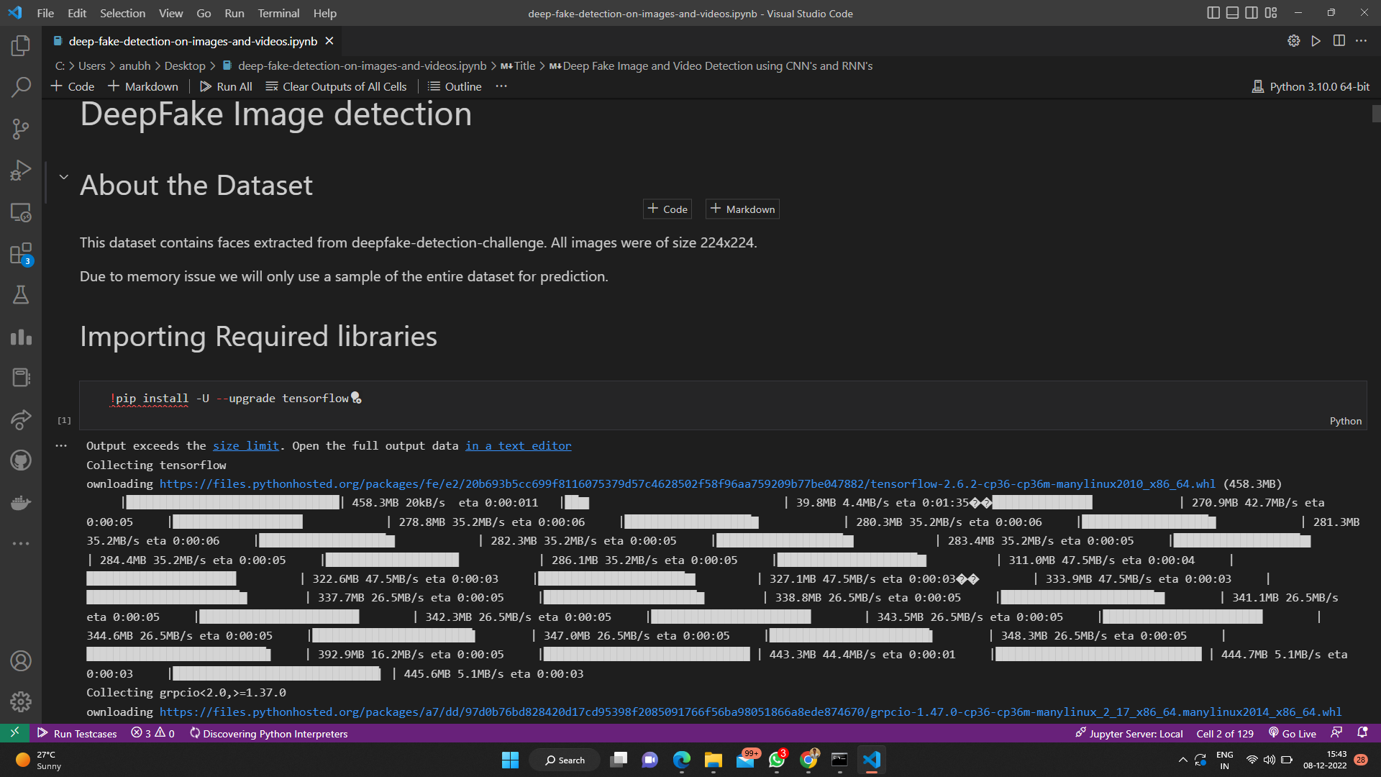

Slide 9
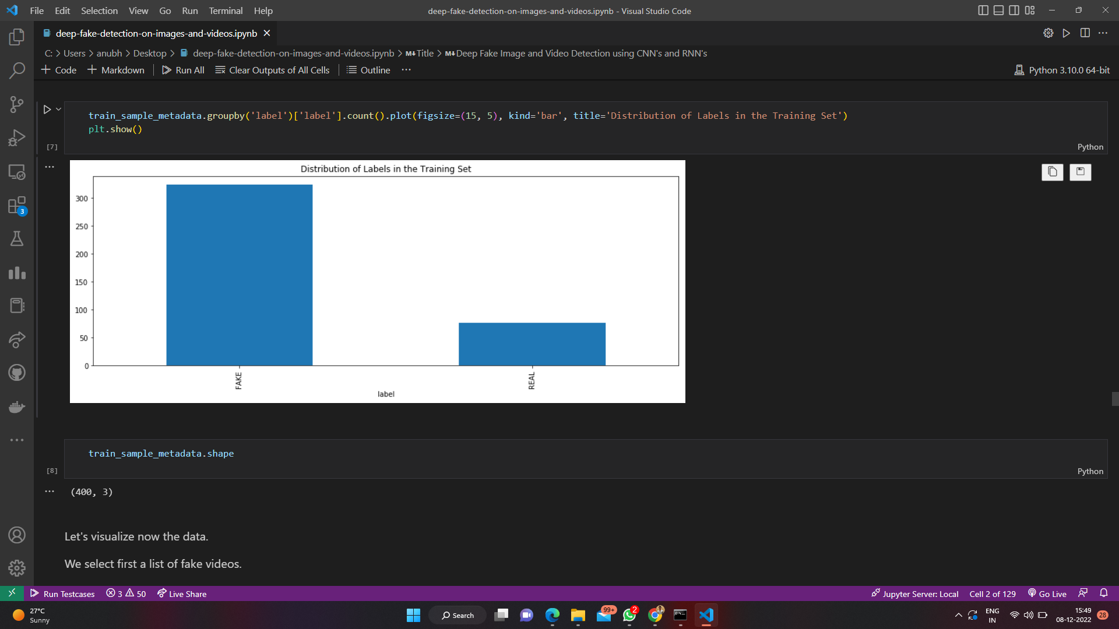
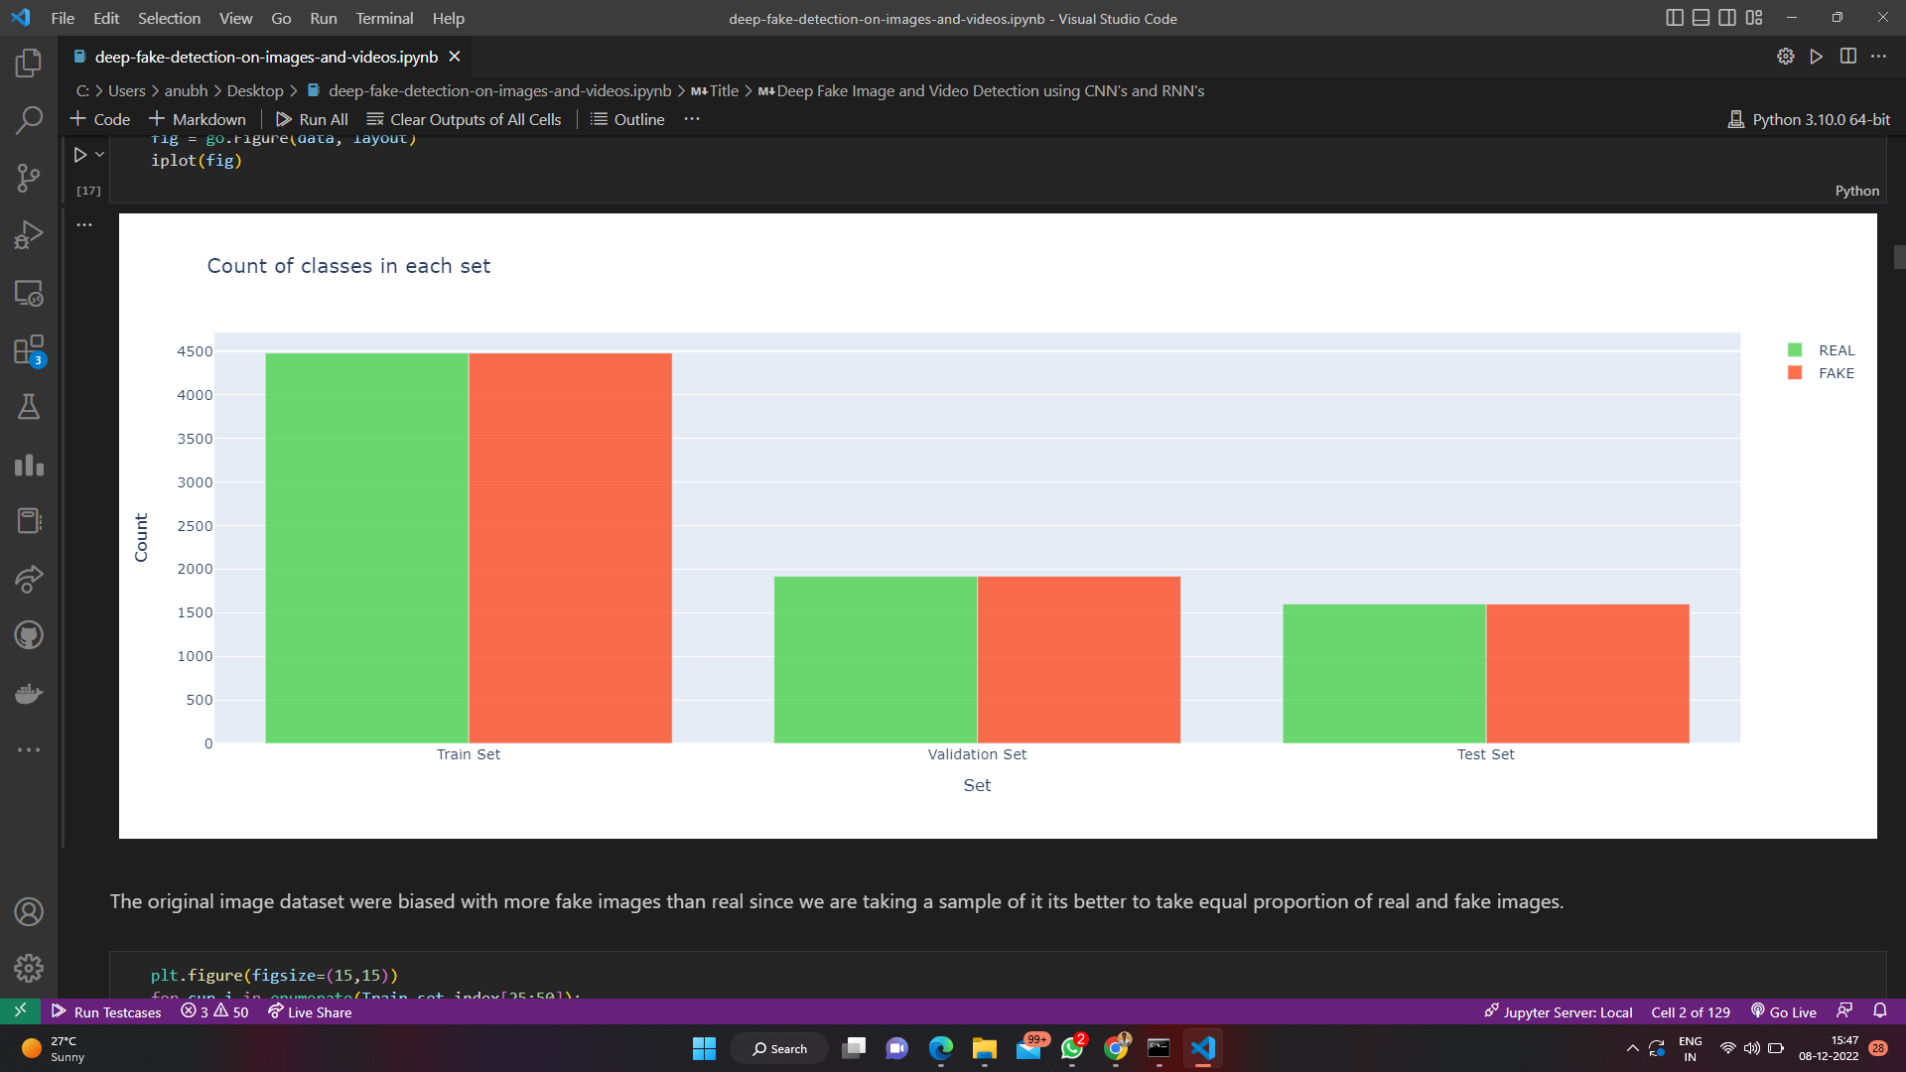

Slide 10
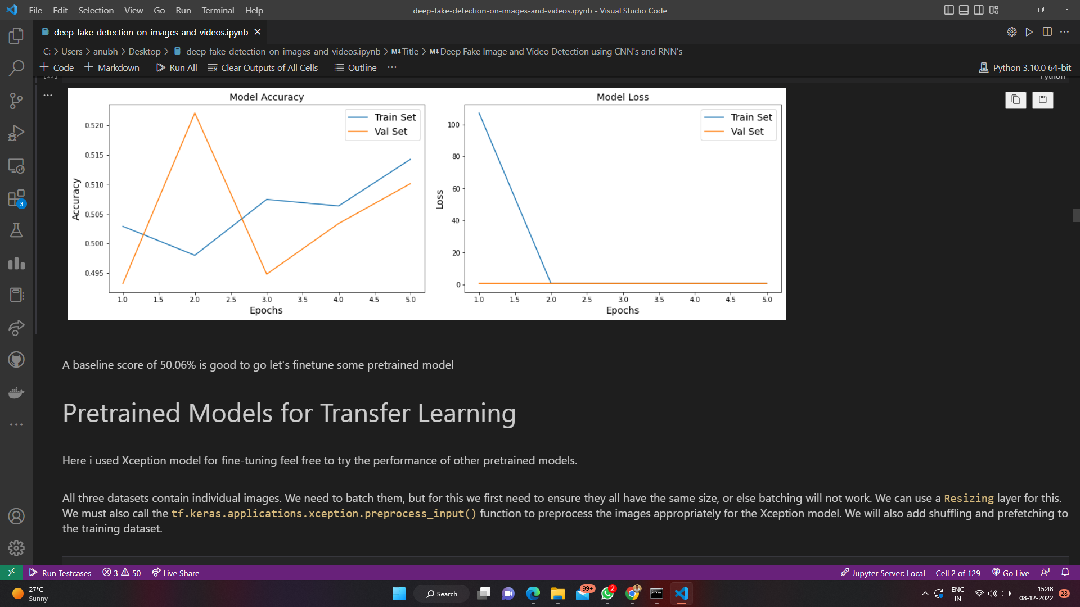
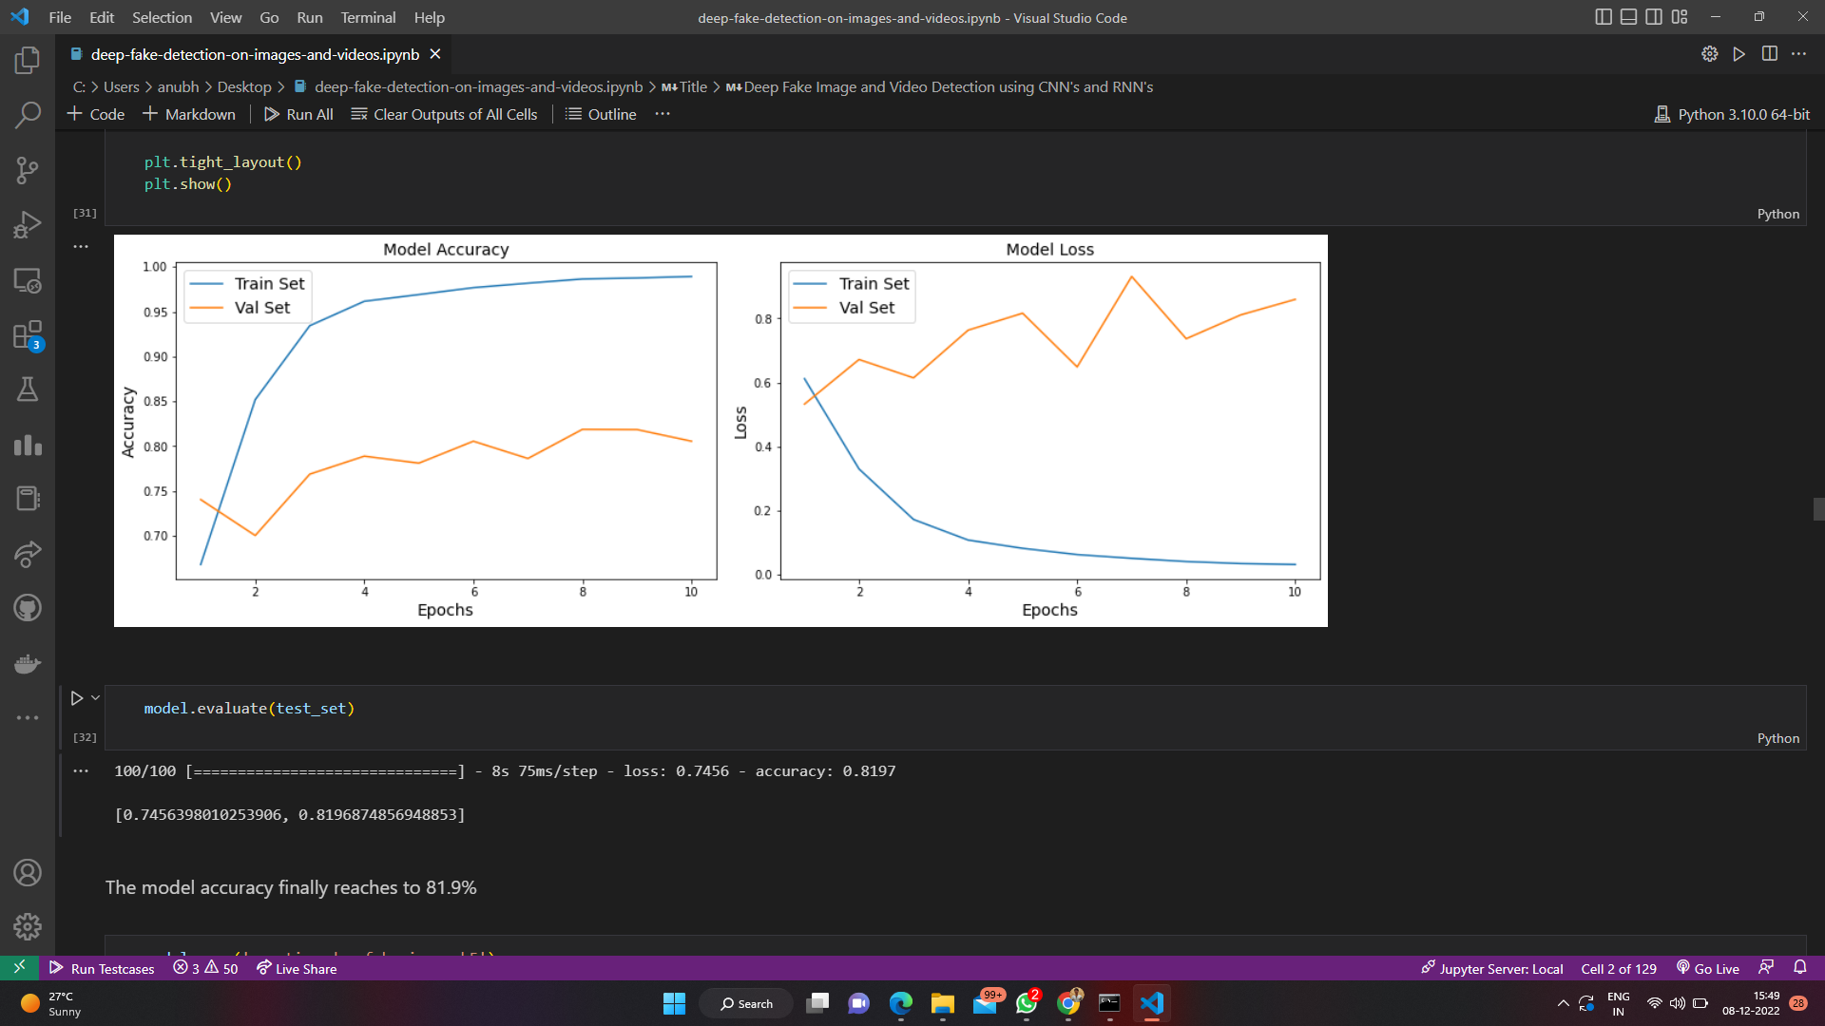
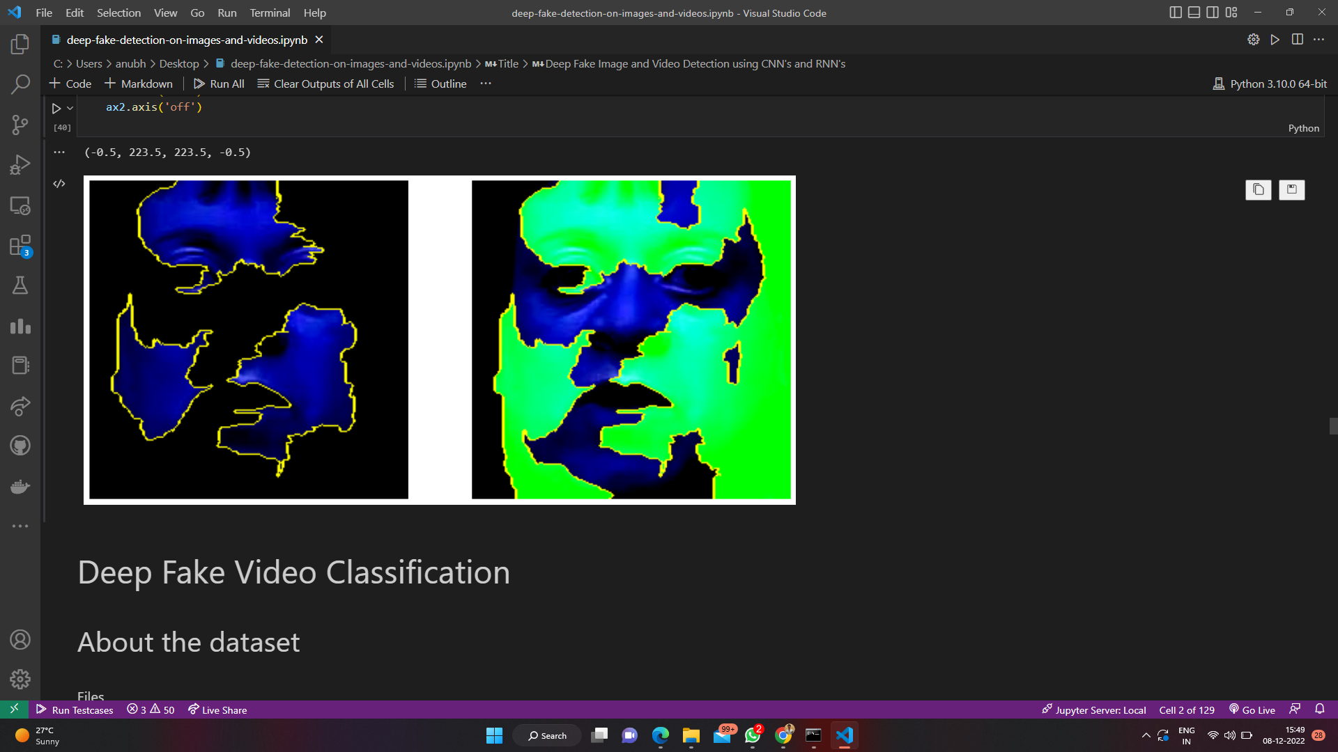

Slide 11
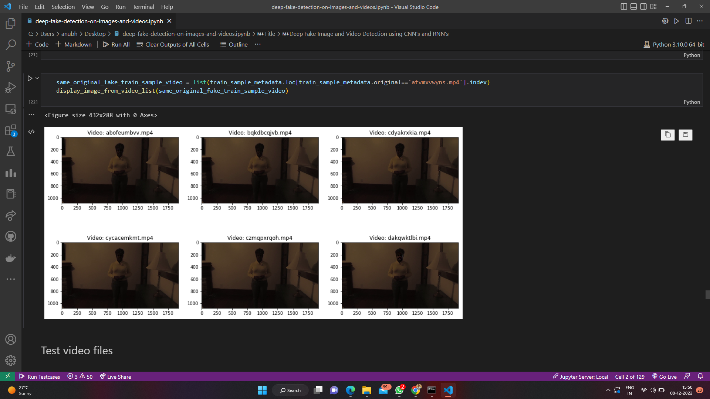
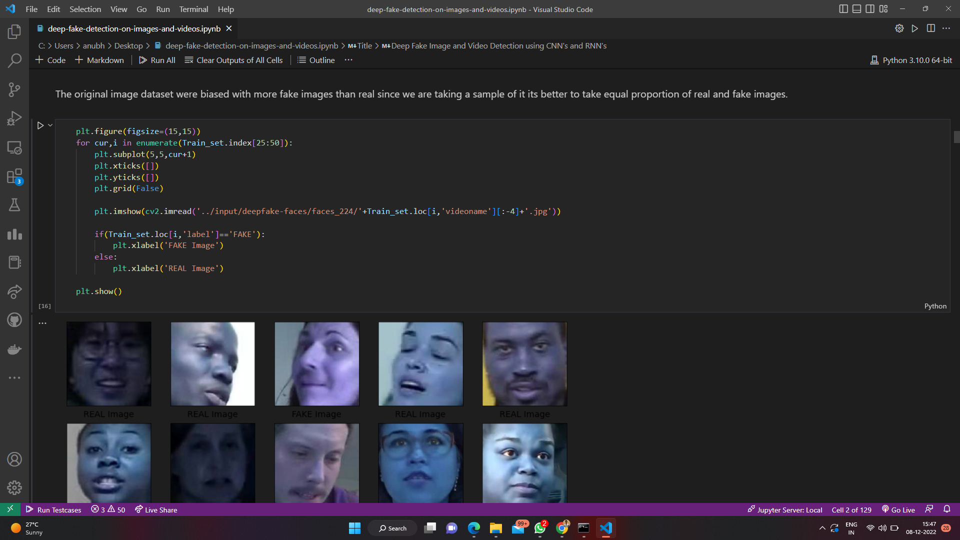
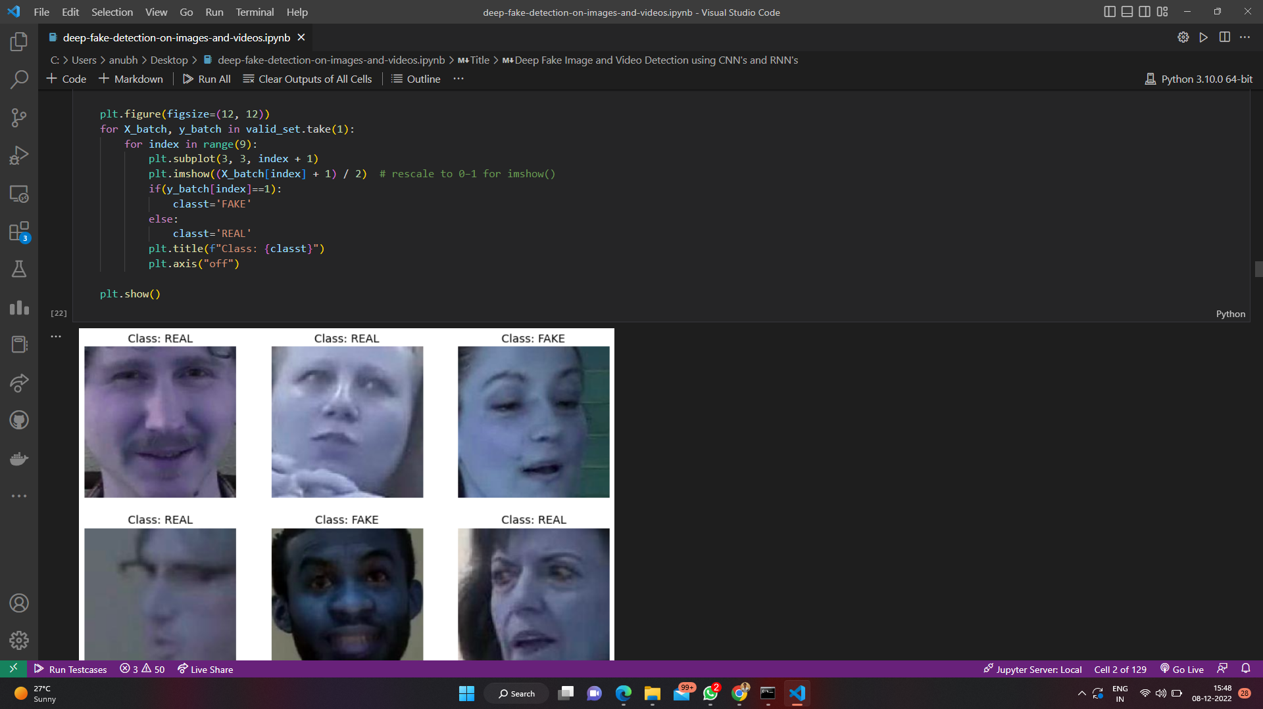

Slide 12
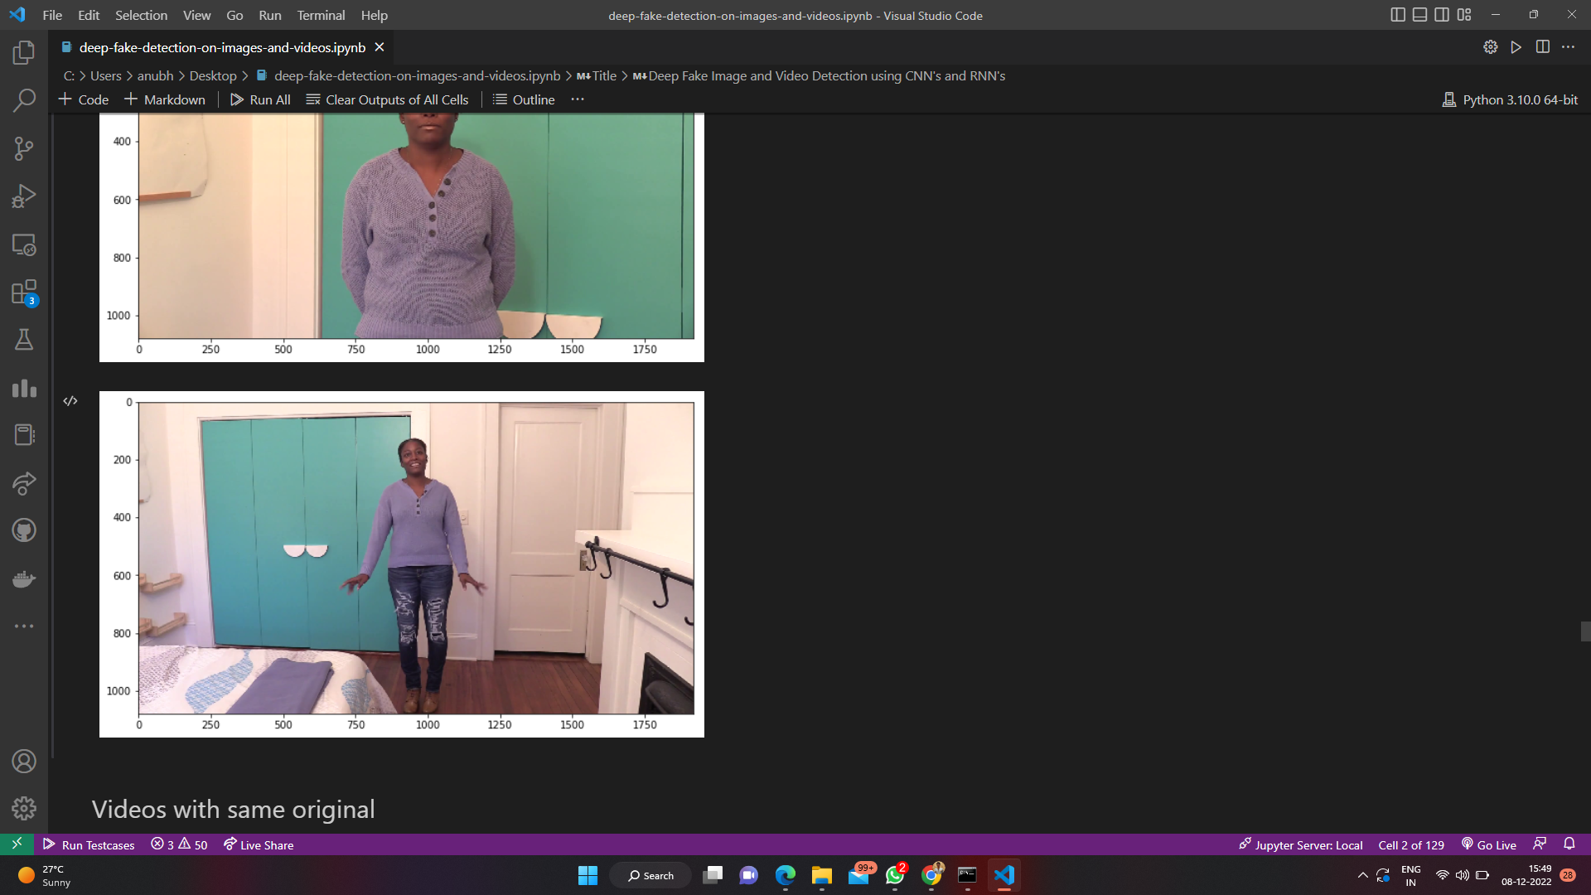
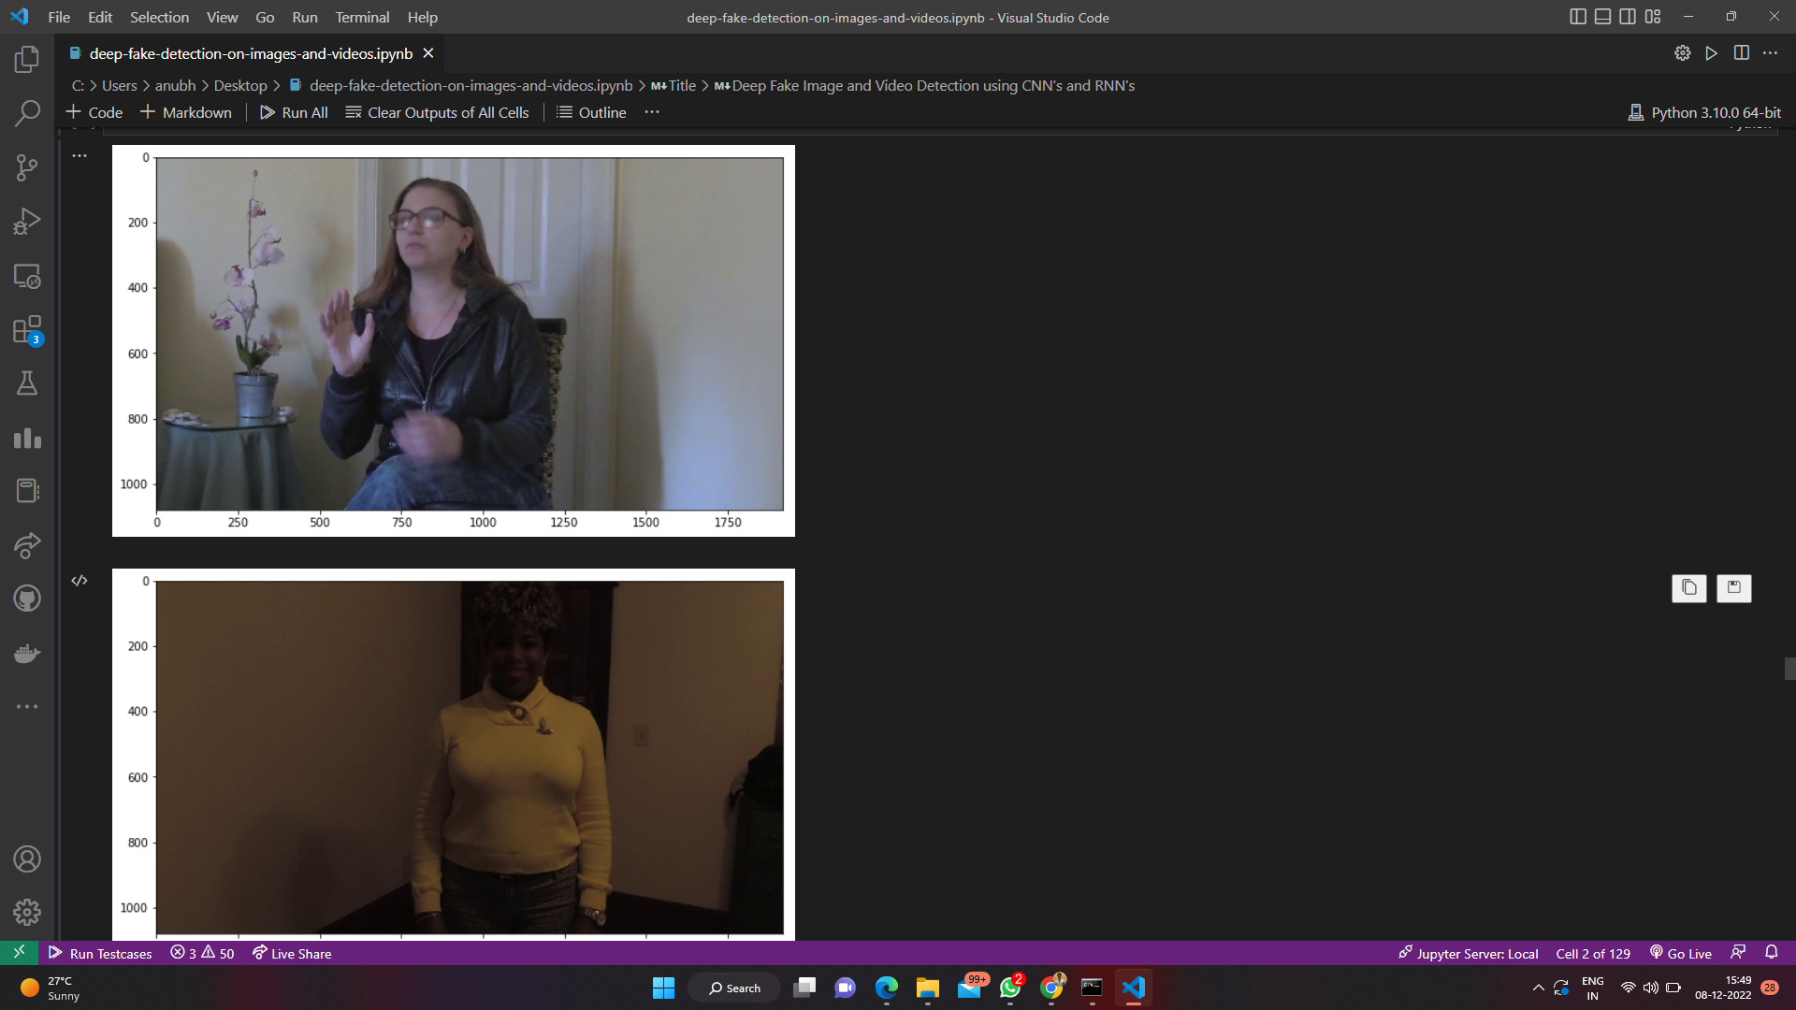
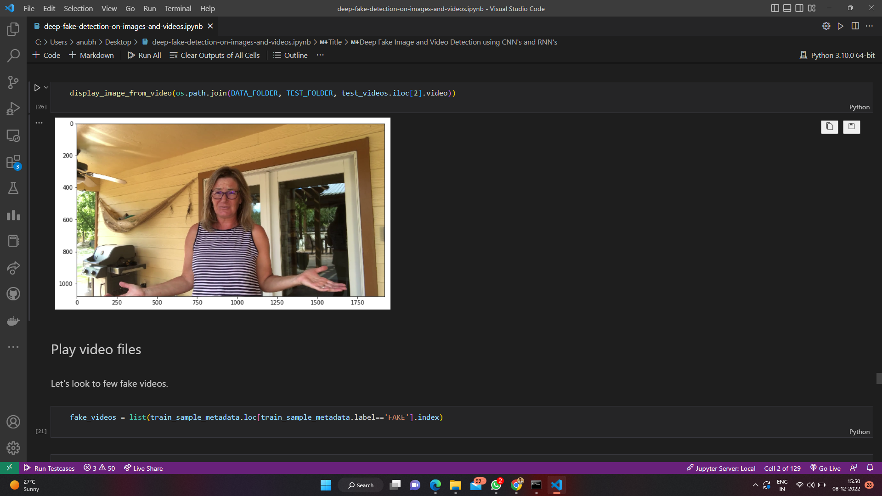

Slide 13
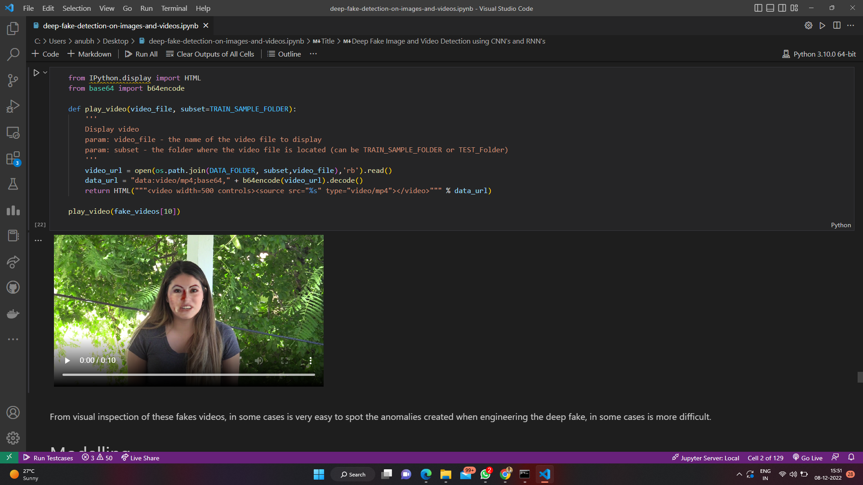
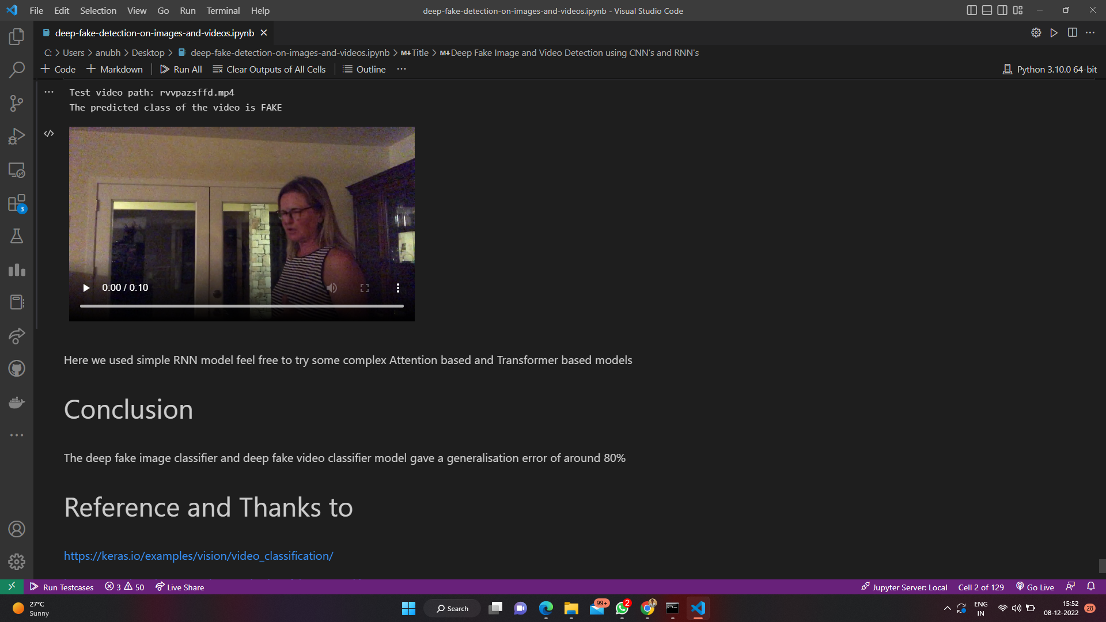
Conclusion:
The deep fake image classifier and deep fake video classifier model gave a generalisation error of around 80%.

Slide 14
References:
• Kamyar Nazeri, Eric Ng, Tony Joseph, Faisal Qureshi, and Mehran Ebrahimi. 2019. EdgeConnect: Structure
Guided Image Inpainting using Edge Prediction. In ICCVW
• Huy H Nguyen, Fuming Fang, Junichi Yamagishi, and Isao Echizen. 2019. Multitask learning for detecting and segmenting manipulated facial images and videos. In BTAS.
• Huy H Nguyen, Junichi Yamagishi, and Isao Echizen. 2019. Use of a capsule network to detect fake images and videos. arXiv preprint arXiv:1910.12467 (2019).
• Andreas Rossler, Davide Cozzolino, Luisa Verdoliva, Christian Riess, Justus Thies, and Matthias Nießner. 2019.
Faceforensics++: Learning to detect manipulated facial images. In ICCV
• Yuezun Li and Siwei Lyu. 2018. Exposing deepfake videos by detecting face warping artifacts. arXiv preprint arXiv:1811.00656 (2018).
• Yuezun Li, Xin Yang, Pu Sun, Honggang Qi, and Siwei Lyu. 2020. Celeb-df: A large-scale challenging dataset for deepfake forensics. In CVPR.

Slide 15
References:
• Deressa Wodajo and Solomon Atnafu. 2021. Deepfake Video Detection Using Convolutional Vision Transformer. arXiv preprint arXiv:2102.11126 (2021)
• Xin Yang, Yuezun Li, and Siwei Lyu. 2019. Exposing deep fakes using inconsistent head poses. In ICASSP.
• Yang Yang and Xiaojie Guo. 2020. Generative Landmark Guided Face Inpainting. In PRCV
• Pavel Korshunov and Sébastien Marcel. 2018. Deepfakes: a new threat to face recognition? assessment and detection. arXiv preprint arXiv:1812.08685 (2018).
• Andreas Rossler, Davide Cozzolino, Luisa Verdoliva, Christian Riess, Justus Thies,
and Matthias Nießner. 2019. Faceforensics++: Learning to detect manipulated facial images. In ICCV

